Slide 1
Preserving your privacy
A guide for military families

Slide 2
Why worry about your privacy?
Specific safety threats to military members and families
Identity theft for adults and children following data breaches
Desire to stay out of the media spotlight
A personal right in the US, guaranteed by the Constitution

Slide 3

Why privacy matters: Glenn greenwald
TedTalk Link

Slide 4
Where does the Online Pii come from?
You disclose it voluntarily:
Search engines, browsers, apps track histories
Social media websites and apps that access contact lists and share files
Shopping discount cards, coupon sites, online shopping sell personal information
Magazine subscriptions, junk mail, charities, colleges share mailing lists
Email marketers sell email addresses and contact lists
News stories, obituaries, school graduations, sports events, etc…

Slide 5
Where does the Online Pii come from?
Public information released legally or breached:
Voter registrations, vehicle registrations, professional licenses, promotion lists
Property transactions, divorce records, traffic violations, accident reports
Phone directories, company data breaches, dark web sharing
Public information widely distributed on websites for general information

Slide 6
What pii did I most want removed?
Children’s names
Phone numbers
Email addresses
Dates of birth
Past and current physical addresses
Profile usernames
Names of other relatives

Slide 7
Tips for beginning
Create a new email account to use for this process (Hotmail or outlook)
Install Mozilla Firefox browser on your computer/tablet
Install a snipping tool for capturing parts of web searches to save instead of screenshots
Create a folder or use a separate thumb drive to save screen clips and docs
Use a spreadsheet or notebook to track your progress

Slide 8
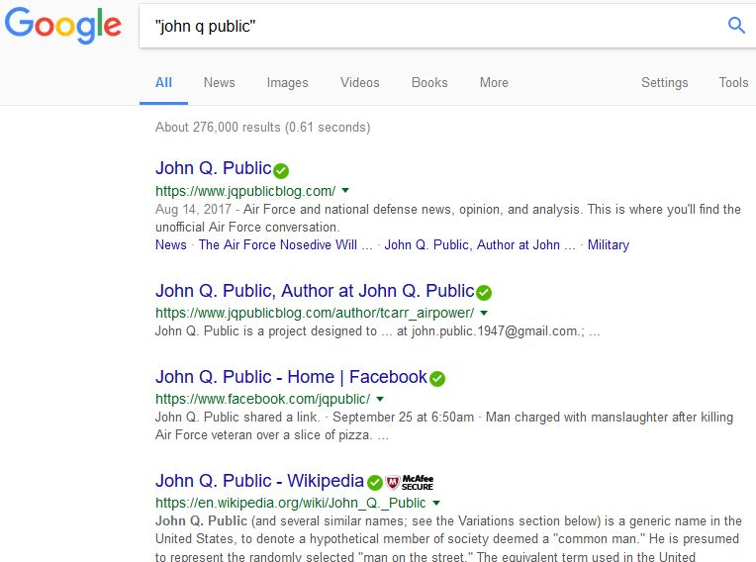
Initial searches for family member names
Type names in quotes. Also search for your email addresses.
Use Google, Bing, Yahoo, DuckDuckGo (minimum)
Use a snipping tool to save results for each page
Don’t follow any links at first.
Be sure to look at Images, Videos, etc...
Angry yet?

Slide 9
Steps to take now that you see who is making money by violating your privacy
Notice where the information is from: do you see info/images from social media accounts, news stories, locations, work information?
Review all social media privacy settings and make them as private as possible. Consider using false/misleading names and information for anything that is public.
Locate your state’s Privacy Policy for voter and vehicle registration and personal licensing. Do they allow exemptions to releasing PII? If so, request it following their policies.

Slide 10
Steps to take now that you see who is making money by violating your privacy
Using the spreadsheet information for specific sites, begin opting out FIRST for the sites that show PII in the search result description. Document what you do for each website and record the date in the spreadsheet.
The major websites should be the next priority. (Smaller sites use their data.) They include Intelius, PeopleFinders, PeopleSmart, Spokeo, and White Pages and probably showed up on the first pages of your searches. See the hierarchical listing in the Workbook on the yellow tab.
For now, ignore any site in the spreadsheet that doesn’t show up in search results. Your first goal is to clear up the search results.

Slide 11
Helpful tips to remember as you work
Companies make this process as tedious as possible to discourage you from opting out of their website. Don’t give up. Use their online instructions, then email, and finally call them when necessary.
Search periodically for new information. New companies are created daily to violate your personal privacy.
If you find your information on a site not listed in the spreadsheet and you can’t locate a way to opt out, search whois.com for the owner of the website/domain. Sometimes you can find information about contacting the owner directly.

Slide 12
Things to think about before the next pcs
Use a Post Office Box for your forwarding address.
PO boxes can be reserved online before you arrive at your new destination.
Update your address (online, phone, or written) with companies you do business with right before moving.
Use false names or initials for magazine subscriptions and catalogs. My cat loves catalogs.
Have an email account designated for shopping cards. Use false names for these. Don’t attach them to your cell phone numbers or use their apps.

Slide 13
Things to think about before the next pcs
What is your new state’s policy regarding releasing public information?
What is the policy of your home of record? Contact them, if necessary.
Complete any exemption paperwork when you register for anything in the state, when possible.
Ask companies about their privacy policies about your PII before signing up. Ask to opt-out up front before giving them any information or doing business with them.
Always give them as little information as possible.
Consider having a land line so you don’t have to give out your cell phone numbers.

